Slide 1
Convolutional Neural Networks

Slide 2
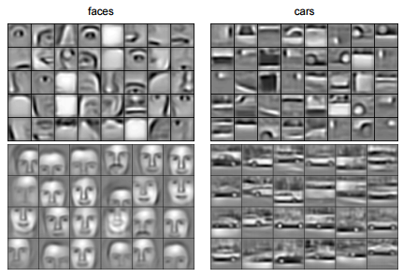
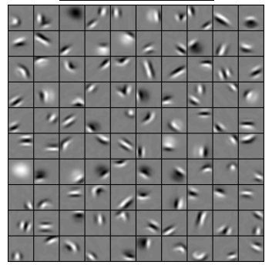
Convolutional Deep Belief Networks for Scalable Unsupervised Learning of Hierarchical Representations

Slide 3
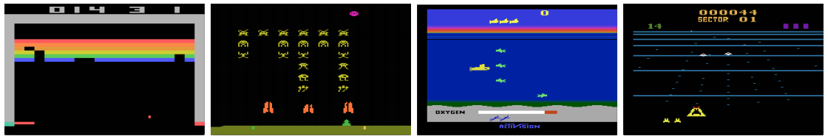
Playing Atari with Deep Reinforcement Learning.

Slide 4
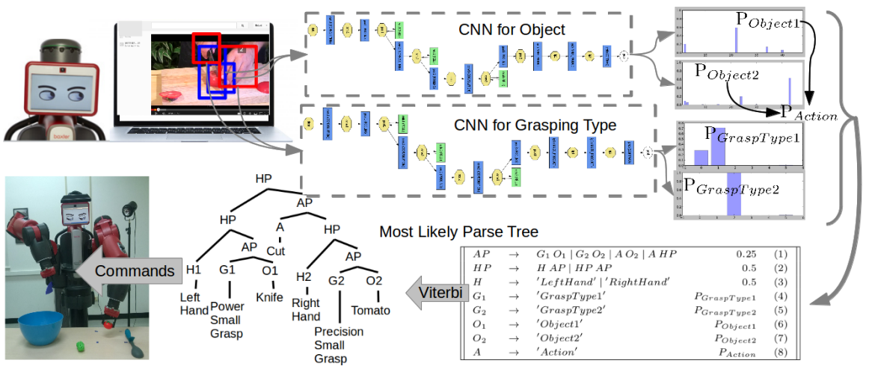
Robot Learning Manipulation Action Plans by “Watching” Unconstrained Videos from the World Wide Web.

Slide 5
A toy ConvNet: X’s and O’s
Says whether a picture is of an X or an O
A two-dimensional
array of pixels
CNN
X or O

Slide 6
For example
CNN
X
CNN
O

Slide 7
Trickier cases
CNN
X
translation
scaling
rotation
weight
CNN
O

Slide 8
Deciding is hard
?
=

Slide 9
What computers see
?
=

Slide 10
What computers see

Slide 11
Computers are literal
=
x

Slide 12
ConvNets match pieces of the image
=
=
=

Slide 13
Features match pieces of the image

Slide 19
Filtering: The math behind the match

Slide 20
Filtering: The math behind the match
Line up the feature and the image patch.
Multiply each image pixel by the corresponding feature pixel.
Add them up.
Divide by the total number of pixels in the feature.

Slide 21
Filtering: The math behind the match
1 x 1 = 1

Slide 22
Filtering: The math behind the match
1 X 1 = 1

Slide 23
Filtering: The math behind the match
-1 x -1 = 1

Slide 24
Filtering: The math behind the match
-1 x -1 = 1

Slide 25
Filtering: The math behind the match
-1 x -1 = 1

Slide 26
Filtering: The math behind the match
1 x 1 = 1

Slide 27
Filtering: The math behind the match
-1 x -1 = 1

Slide 28
Filtering: The math behind the match
-1 x -1 = 1

Slide 29
Filtering: The math behind the match
-1 x -1 = 1

Slide 30
Filtering: The math behind the match
1 x 1 = 1

Slide 31

Filtering: The math behind the match
$$\frac{1+1+1+1+1+1+1+1+1}{9}=1$$

Slide 32
Filtering: The math behind the match
1 x 1 = 1

Slide 33
Filtering: The math behind the match
-1 x 1 = -1

Slide 34
Filtering: The math behind the match

Slide 35

Filtering: The math behind the match
$$\frac{1+1−1+1+1+1−1+1+1}{9}=.55$$
.55

Slide 36
Convolution: Trying every possible match

Slide 37
Convolution: Trying every possible match
=

Slide 38
=
=
=

Slide 39
Convolution layer
One image becomes a stack of filtered images

Slide 40
Convolution layer
One image becomes a stack of filtered images

Slide 41
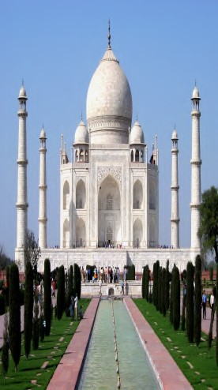
We can think of images as 2D inputs

Slide 42
We can think of images as 2D inputs
We would now like to use a 2D filter (m × n)

Slide 43
We can think of images as 2D inputs
We would now like to use a 2D filter (m × n)
First let us see what the 2D formula looks like

Slide 44

We can think of images as 2D inputs
We would now like to use a 2D filter (m × n)
First let us see what the 2D formula looks like
This formula looks at all the preced- ing neighbours (i − a, j − b)

Slide 45
We can think of images as 2D inputs
We would now like to use a 2D filter (m × n)
First let us see what the 2D formula looks like
This formula looks at all the preced- ing neighbours (i − a, j − b)
In practice, we use the following for- mula which looks at the succeeding neighbours

Slide 46
Let us apply this idea to a toy ex- ample and see the results

Slide 47
Let us apply this idea to a toy ex- ample and see the results
Input
a | b | c | d
e | f | g | h
i | j | k | A
Kernel
w | x
y | z
Output
aw+bx+ey+fz

Slide 48
Let us apply this idea to a toy ex- ample and see the results
Input
a | b | c | d
e | f | g | h
i | j | k | A
Kernel
w | x
y | z
Output
aw+bx+ey+fz | bw+cx+fy+gz

Slide 49
Let us apply this idea to a toy ex- ample and see the results
Input
a | b | c | d
e | f | g | h
i | j | k | A
Kernel
w | x
y | z
Output
aw+bx+ey+fz | bw+cx+fy+gz | cw+dx+gy+hz

Slide 50
Let us apply this idea to a toy ex- ample and see the results
Input
a | b | c | d
e | f | g | h
i | j | k | A
Kernel
w | x
y | z
Output
aw+bx+ey+fz | bw+cx+fy+gz | cw+dx+gy+hz
ew+fx+iy+jz

Slide 51
Let us apply this idea to a toy ex- ample and see the results
Input
a | b | c | d
e | f | g | h
i | j | k | A
Kernel
w | x
y | z
Output
aw+bx+ey+fz | bw+cx+fy+gz | cw+dx+gy+hz
ew+fx+iy+jz | fw+gx+jy+kz

Slide 52
Let us apply this idea to a toy ex- ample and see the results
Input
a | b | c | d
e | f | g | h
i | j | k | A
Kernel
w | x
y | z
Output
aw+bx+ey+fz | bw+cx+fy+gz | cw+dx+gy+hz
ew+fx+iy+jz | fw+gx+jy+kz | gw+hx+ky+Az

Slide 53
For the rest of the discussion we will use the following formula for convolu- tion

Slide 54
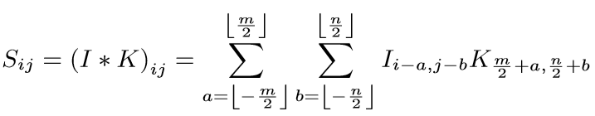
For the rest of the discussion we will use the following formula for convolu- tion

Slide 55
For the rest of the discussion we will use the following formula for convolu- tion
In other words we will assume that the kernel is centered on the pixel of interest
pixel of interest

Slide 56
For the rest of the discussion we will use the following formula for convolu- tion
In other words we will assume that the kernel is centered on the pixel of interest
So we will be looking at both preceed- ing and succeeding neighbors
pixel of interest

Slide 57
Let us see some examples of 2D convolutions applied to images

Slide 58

1 1 1
∗ 1 1 1 =
1 1 1

Slide 59
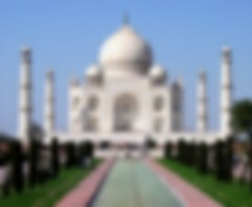
1 1 1
∗ 1 1 1 =
1 1 1
blurs the image

Slide 60
0 -1 0
∗ -1 5 -1 =
0 -1 0

Slide 61
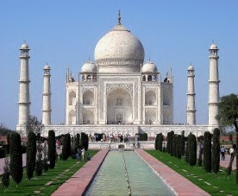
0 -1 0
∗ -1 5 -1 =
0 -1 0
sharpens the image

Slide 62
1 1 1
∗ 1 -8 1 =
1 1 1

Slide 63
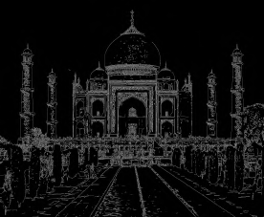
1 1 1
∗ 1 -8 1 =
1 1 1
detects the edges

Slide 64
We will now see a working example of 2D convolution.

Slide 65
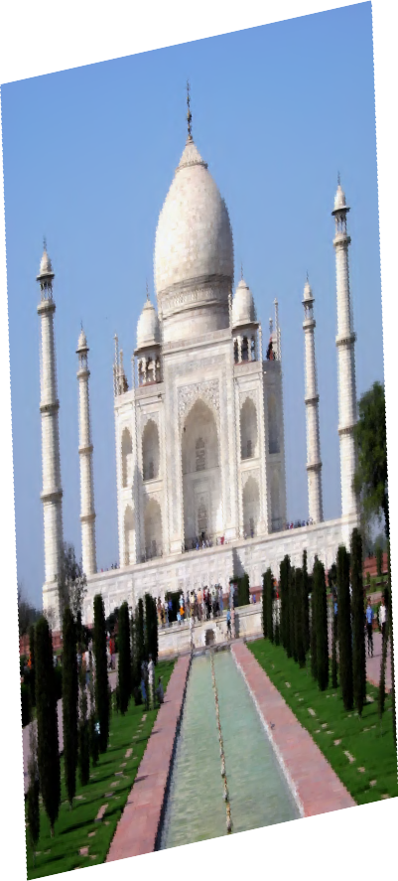
We just slide the kernel over the input image

Slide 66
We just slide the kernel over the input image
Each time we slide the kernel we get one value in the output

Slide 67
We just slide the kernel over the input image
Each time we slide the kernel we get one value in the output

Slide 68
We just slide the kernel over the input image
Each time we slide the kernel we get one value in the output

Slide 69
We just slide the kernel over the input image
Each time we slide the kernel we get one value in the output

Slide 70
We just slide the kernel over the input image
Each time we slide the kernel we get one value in the output

Slide 71
We just slide the kernel over the input image
Each time we slide the kernel we get one value in the output

Slide 72
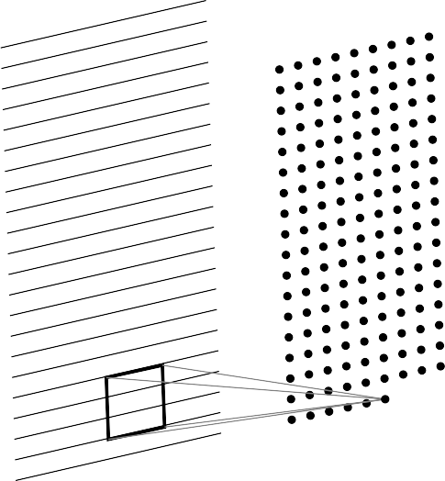
We just slide the kernel over the input image
Each time we slide the kernel we get one value in the output

Slide 73
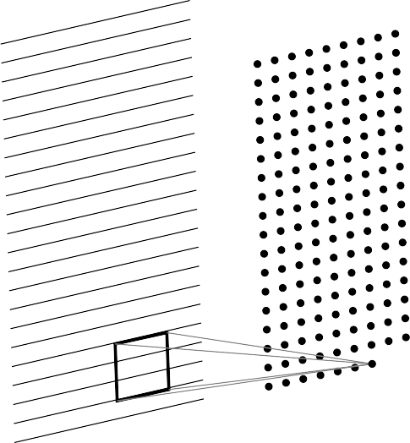
We just slide the kernel over the input image
Each time we slide the kernel we get one value in the output

Slide 74
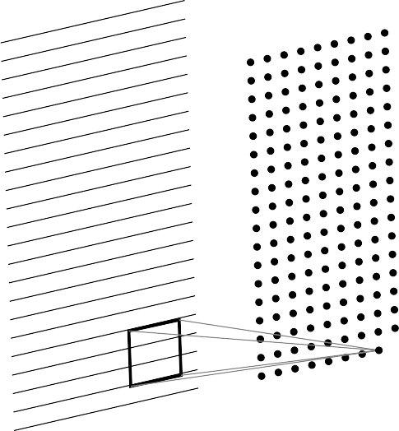
We just slide the kernel over the input image
Each time we slide the kernel we get one value in the output

Slide 75
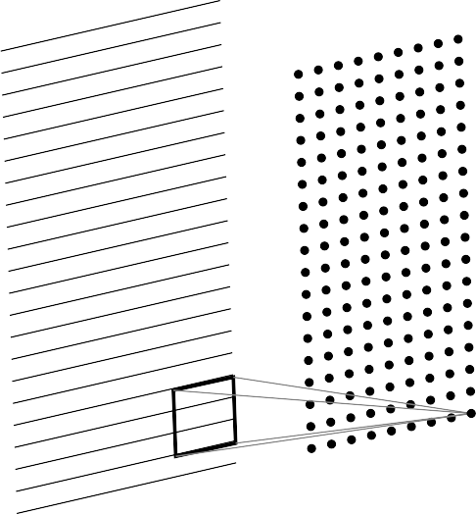
We just slide the kernel over the input image
Each time we slide the kernel we get one value in the output

Slide 76
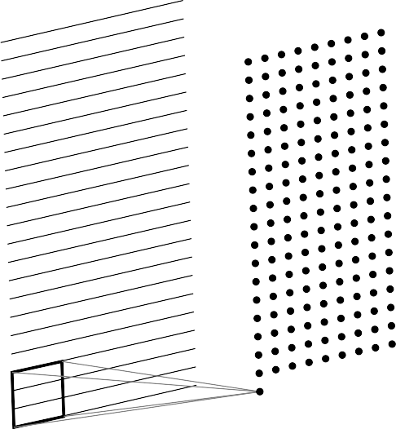
We just slide the kernel over the input image
Each time we slide the kernel we get one value in the output

Slide 77
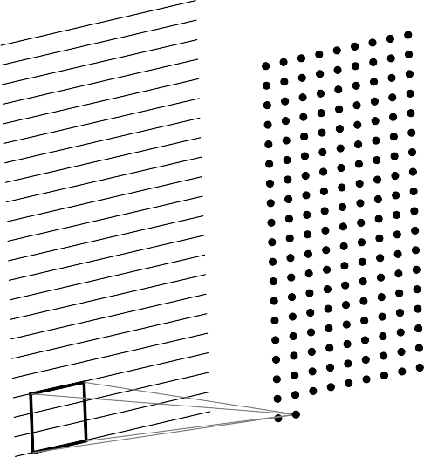
We just slide the kernel over the input image
Each time we slide the kernel we get one value in the output

Slide 78
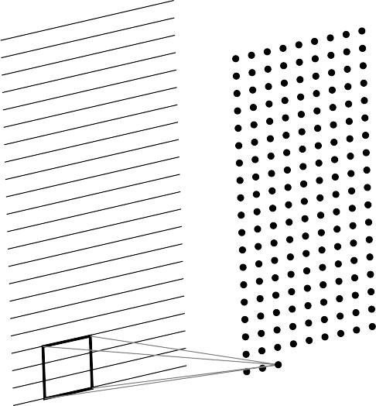
We just slide the kernel over the input image
Each time we slide the kernel we get one value in the output

Slide 79
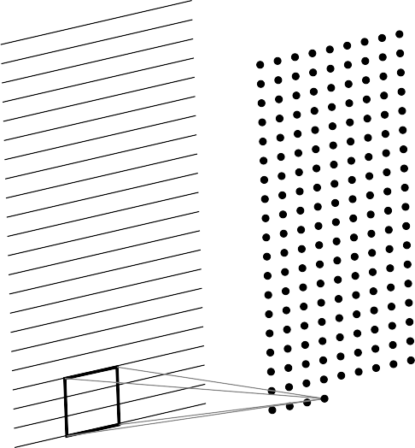
We just slide the kernel over the input image
Each time we slide the kernel we get one value in the output

Slide 80
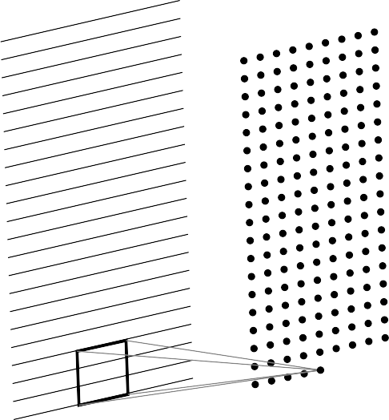
We just slide the kernel over the input image
Each time we slide the kernel we get one value in the output

Slide 81
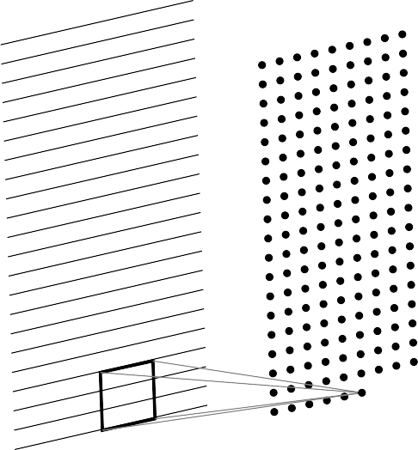
We just slide the kernel over the input image
Each time we slide the kernel we get one value in the output

Slide 82
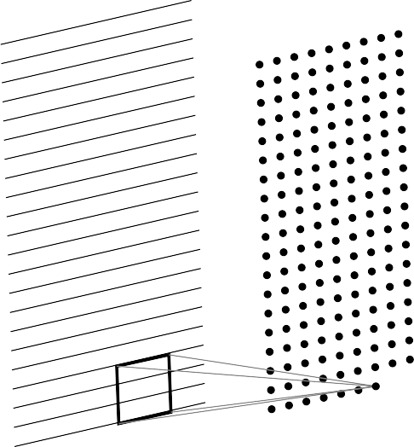
We just slide the kernel over the input image
Each time we slide the kernel we get one value in the output

Slide 83
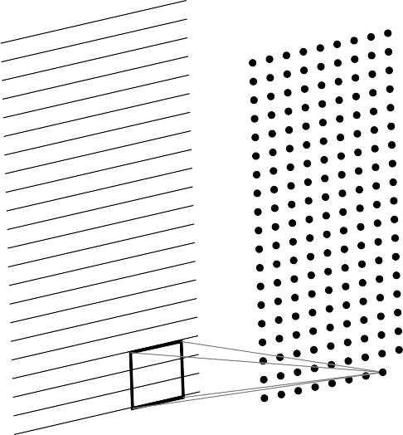
We just slide the kernel over the input image
Each time we slide the kernel we get one value in the output

Slide 84
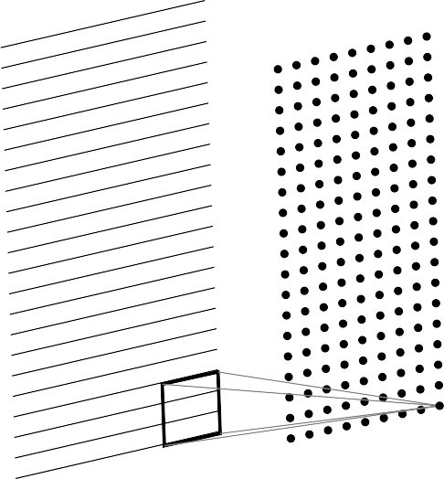
We just slide the kernel over the input image
Each time we slide the kernel we get one value in the output
The resulting output is called a fea- ture map.

Slide 85

We just slide the kernel over the input image
Each time we slide the kernel we get one value in the output
The resulting output is called a fea- ture map.
We can use multiple filters to get mul- tiple feature maps.

Slide 86
Question
In the 1D case, we slide a one dimensional filter over a one dimensional input

Slide 87
Question
In the 1D case, we slide a one dimensional filter over a one dimensional input
A | B | C | B | A | B | C

Slide 88
Question
A
B | C | B | A | B | C
In the 1D case, we slide a one dimensional filter over a one dimensional input

Slide 89
Question
In the 1D case, we slide a one dimensional filter over a one dimensional input
A | B | C | B | A | B | C

Slide 90
Question
In the 1D case, we slide a one dimensional filter over a one dimensional input
A | B | C | B | A | B | C

Slide 91
Question
In the 1D case, we slide a one dimensional filter over a one dimensional input
A | B | C | B | A | B | C

Slide 92
Question
In the 1D case, we slide a one dimensional filter over a one dimensional input
In the 2D case, we slide a two dimen- stional filter over a two dimensional out- put

Slide 93
a | b | c | d
e | f | g | h
i | j | k | l
Question
In the 1D case, we slide a one dimensional filter over a one dimensional input
In the 2D case, we slide a two dimen- stional filter over a two dimensional out- put

Slide 94
a | b | c | d
e | f | g | h
i | j | k | l
Question
In the 1D case, we slide a one dimensional filter over a one dimensional input
In the 2D case, we slide a two dimen- stional filter over a two dimensional out- put

Slide 95
a | b | c | d
e | f | g | h
i | j | k | l
Question
In the 1D case, we slide a one dimensional filter over a one dimensional input
In the 2D case, we slide a two dimen- stional filter over a two dimensional out- put

Slide 96
a | b | c | d
e | f | g | h
i | j | k | l
Question
In the 1D case, we slide a one dimensional filter over a one dimensional input
In the 2D case, we slide a two dimen- stional filter over a two dimensional out- put

Slide 97
a | b | c | d
e | f | g | h
i | j | k | l
Question
In the 1D case, we slide a one dimensional filter over a one dimensional input
In the 2D case, we slide a two dimen- stional filter over a two dimensional out- put

Slide 98
a | b | c | d
e | f | g | h
i | j | k | l
Question
In the 1D case, we slide a one dimensional filter over a one dimensional input
In the 2D case, we slide a two dimen- stional filter over a two dimensional out- put

Slide 99
Question
In the 1D case, we slide a one dimensional filter over a one dimensional input
In the 2D case, we slide a two dimen- stional filter over a two dimensional out- put
What would happen in the 3D case?

Slide 100
R G B
What would a 3D filter look like?
INPUT

Slide 101
R G B
What would a 3D filter look like?
It will be 3D and we will refer to it as a volume
ftlter
INPUT

Slide 102
What would a 3D filter look like?
R G B
It will be 3D and we will refer to it as a volume
Once again we will slide the volume over the 3D input and compute the convolution oper- ation
OUTPUT
INPUT

Slide 103
What would a 3D filter look like?
R G B
It will be 3D and we will refer to it as a volume
Once again we will slide the volume over the 3D input and compute the convolution oper- ation
OUTPUT
INPUT

Slide 104
What would a 3D filter look like?
R G B
It will be 3D and we will refer to it as a volume
Once again we will slide the volume over the 3D input and compute the convolution oper- ation
OUTPUT
INPUT

Slide 105
What would a 3D filter look like?
R G B
It will be 3D and we will refer to it as a volume
Once again we will slide the volume over the 3D input and compute the convolution oper- ation
OUTPUT
INPUT

Slide 106
What would a 3D filter look like?
R G B
It will be 3D and we will refer to it as a volume
Once again we will slide the volume over the 3D input and compute the convolution oper- ation
OUTPUT
INPUT

Slide 107
What would a 3D filter look like?
R G B
It will be 3D and we will refer to it as a volume
Once again we will slide the volume over the 3D input and compute the convolution oper- ation
OUTPUT
INPUT

Slide 108
What would a 3D filter look like?
R G B
It will be 3D and we will refer to it as a volume
Once again we will slide the volume over the 3D input and compute the convolution oper- ation
OUTPUT
INPUT

Slide 109
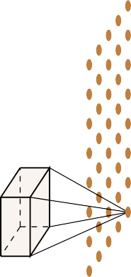
What would a 3D filter look like?
R G B
It will be 3D and we will refer to it as a volume
Once again we will slide the volume over the 3D input and compute the convolution oper- ation
OUTPUT
INPUT

Slide 110
What would a 3D filter look like?
R G B
It will be 3D and we will refer to it as a volume
Once again we will slide the volume over the 3D input and compute the convolution oper- ation
OUTPUT
INPUT

Slide 111
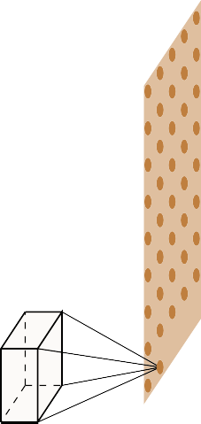
What would a 3D filter look like?
R G B
It will be 3D and we will refer to it as a volume
Once again we will slide the volume over the 3D input and compute the convolution oper- ation
OUTPUT
INPUT

Slide 112
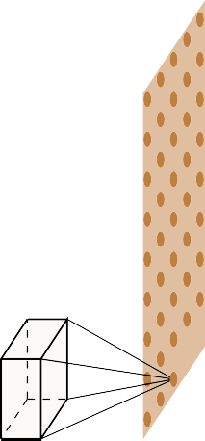
What would a 3D filter look like?
R G B
It will be 3D and we will refer to it as a volume
Once again we will slide the volume over the 3D input and compute the convolution oper- ation
OUTPUT
INPUT

Slide 113
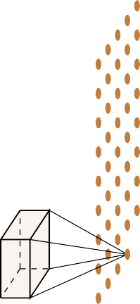
What would a 3D filter look like?
R G B
It will be 3D and we will refer to it as a volume
Once again we will slide the volume over the 3D input and compute the convolution oper- ation
OUTPUT
INPUT

Slide 114
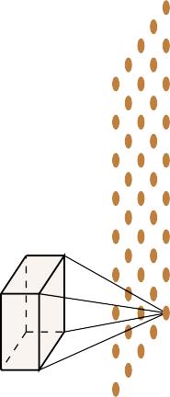
What would a 3D filter look like?
R G B
It will be 3D and we will refer to it as a volume
Once again we will slide the volume over the 3D input and compute the convolution oper- ation
Note that in this lecture we will assume that the filter always extends to the depth of the image
OUTPUT
INPUT

Slide 115

What would a 3D filter look like?
R G B
It will be 3D and we will refer to it as a volume
Once again we will slide the volume over the 3D input and compute the convolution oper- ation
Note that in this lecture we will assume that the filter always extends to the depth of the image
In effect, we are doing a 2D convolution oper- ation on a 3D input (because the filter moves along the height and the width but not along the depth)
OUTPUT
INPUT

Slide 116
What would a 3D filter look like?
R G B
It will be 3D and we will refer to it as a volume
Once again we will slide the volume over the 3D input and compute the convolution oper- ation
Note that in this lecture we will assume that the filter always extends to the depth of the image
In effect, we are doing a 2D convolution oper- ation on a 3D input (because the filter moves along the height and the width but not along the depth)
As a result the output will be 2D (only width and height, no depth)
OUTPUT
INPUT

Slide 117
What would a 3D filter look like?
R G B
It will be 3D and we will refer to it as a volume
Once again we will slide the volume over the 3D input and compute the convolution oper- ation
Note that in this lecture we will assume that the filter always extends to the depth of the image
In effect, we are doing a 2D convolution oper- ation on a 3D input (because the filter moves along the height and the width but not along the depth)
As a result the output will be 2D (only width and height, no depth)
Once again we can apply multiple filters to get
OUTPUT
INPUT
multiple feature maps

Slide 118
Relation between input size, output size and filter size

Slide 119
So far we have not said anything explicit about the dimensions of the

Slide 120
So far we have not said anything explicit about the dimensions of the
inputs

Slide 121
So far we have not said anything explicit about the dimensions of the
inputs filters

Slide 122
So far we have not said anything explicit about the dimensions of the
inputs filters outputs

Slide 123
So far we have not said anything explicit about the dimensions of the
inputs filters outputs
and the relations between them

Slide 124
So far we have not said anything explicit about the dimensions of the
inputs filters outputs
and the relations between them
We will see how they are related but before that we will define a few quantities

Slide 125
We first define the following quantit- ies

Slide 126
We first define the following quantit- ies
Width (W₁),
W1

Slide 127
We first define the following quantit- ies
Width (W₁), Height (H₁)
H1
W1

Slide 128
We first define the following quantit- ies
Width (W₁), Height (H₁) and Depth (D₁) of the original input
H1
W1
D1

Slide 129
We first define the following quantit- ies
Width (W₁), Height (H₁) and Depth (D₁) of the original input
The Stride S (We will come back to this later)
H1
W1
D1

Slide 130
We first define the following quantit- ies
Width (W₁), Height (H₁) and Depth (D₁) of the original input
The Stride S (We will come back to this later)
H1
W1
D1

Slide 131
We first define the following quantit- ies
Width (W₁), Height (H₁) and Depth (D₁) of the original input
The Stride S (We will come back to this later)
The number of filters K
H1
W1
D1

Slide 132
We first define the following quantit- ies
Width (W₁), Height (H₁) and Depth (D₁) of the original input
The Stride S (We will come back to this later)
The number of filters K
The spatial extent (F ) of each filter (the depth of each filter is same as the depth of each input)
F
F
D1
H1
W1
D1

Slide 133
We first define the following quantit- ies
Width (W₁), Height (H₁) and Depth (D₁) of the original input
The Stride S (We will come back to this later)
The number of filters K
The spatial extent (F ) of each filter (the depth of each filter is same as the depth of each input)
F
F
D1
H2
H1
The output is W₂ × H₂ × D₂ (we will
W2
soon see a formula for computing W₂, H₂ and D₂)
W1
D2
D1

Slide 134
Let us compute the dimension (W2, H2) of the output

Slide 135

Let us compute the dimension (W2, H2) of the output
=

Slide 136

Let us compute the dimension (W2, H2) of the output
=

Slide 137

Let us compute the dimension (W2, H2) of the output
=

Slide 138

Let us compute the dimension (W2, H2) of the output
=

Slide 139

Let us compute the dimension (W2, H2) of the output
=

Slide 140

Let us compute the dimension (W2, H2) of the output
=

Slide 141
Let us compute the dimension (W2, H2) of the output
Notice that we can’t place the kernel at the corners as it will cross the input boundary
=
pixel of interest

Slide 142
Let us compute the dimension (W2, H2) of the output
Notice that we can’t place the kernel at the corners as it will cross the input boundary
=

Slide 143
Let us compute the dimension (W2, H2) of the output
Notice that we can’t place the kernel at the corners as it will cross the input boundary
This is true for all the shaded points (the kernel crosses the input boundary)
=

Slide 144
Let us compute the dimension (W2, H2) of the output
Notice that we can’t place the kernel at the corners as it will cross the input boundary
This is true for all the shaded points (the kernel crosses the input boundary)
This results in an output which is of smaller dimensions than the input
=

Slide 145
Let us compute the dimension (W2, H2) of the output
Notice that we can’t place the kernel at the corners as it will cross the input boundary
This is true for all the shaded points (the kernel crosses the input boundary)
This results in an output which is of smaller dimensions than the input
As the size of the kernel increases, this be- comes true for even more pixels
=

Slide 146

Let us compute the dimension (W2, H2) of the output
Notice that we can’t place the kernel at the corners as it will cross the input boundary
This is true for all the shaded points (the kernel crosses the input boundary)
This results in an output which is of smaller dimensions than the input
As the size of the kernel increases, this be- comes true for even more pixels
For example, let’s consider a 5 × 5 kernel
=

Slide 147

Let us compute the dimension (W2, H2) of the output
Notice that we can’t place the kernel at the corners as it will cross the input boundary
This is true for all the shaded points (the kernel crosses the input boundary)
This results in an output which is of smaller dimensions than the input
As the size of the kernel increases, this be- comes true for even more pixels
For example, let’s consider a 5 × 5 kernel We have an even smaller output now
=

Slide 148

Let us compute the dimension (W2, H2) of the output
Notice that we can’t place the kernel at the corners as it will cross the input boundary
This is true for all the shaded points (the kernel crosses the input boundary)
This results in an output which is of smaller dimensions than the input
As the size of the kernel increases, this be- comes true for even more pixels
For example, let’s consider a 5 × 5 kernel We have an even smaller output now
=

Slide 149

Let us compute the dimension (W2, H2) of the output
Notice that we can’t place the kernel at the corners as it will cross the input boundary
This is true for all the shaded points (the kernel crosses the input boundary)
This results in an output which is of smaller dimensions than the input
As the size of the kernel increases, this be- comes true for even more pixels
For example, let’s consider a 5 × 5 kernel We have an even smaller output now
=

Slide 150
Let us compute the dimension (W2, H2) of the output
Notice that we can’t place the kernel at the corners as it will cross the input boundary
This is true for all the shaded points (the kernel crosses the input boundary)
This results in an output which is of smaller dimensions than the input
As the size of the kernel increases, this be- comes true for even more pixels
For example, let’s consider a 5 × 5 kernel We have an even smaller output now
=
pixel of interest

Slide 151
Let us compute the dimension (W2, H2) of the output
Notice that we can’t place the kernel at the corners as it will cross the input boundary
This is true for all the shaded points (the kernel crosses the input boundary)
This results in an output which is of smaller dimensions than the input
As the size of the kernel increases, this be- comes true for even more pixels
For example, let’s consider a 5 × 5 kernel We have an even smaller output now
=
pixel of interest

Slide 152
Let us compute the dimension (W2, H2) of the output
Notice that we can’t place the kernel at the corners as it will cross the input boundary
This is true for all the shaded points (the kernel crosses the input boundary)
This results in an output which is of smaller dimensions than the input
As the size of the kernel increases, this be- comes true for even more pixels
For example, let’s consider a 5 × 5 kernel We have an even smaller output now
=
In general, W₂ = W₁ − F + 1
H₂ = H₁ − F + 1
We will refine this formula further

Slide 153
What if we want the output to be of same size as the input?

Slide 154
What if we want the output to be of same size as the input?
We can use something known as padding

Slide 155
What if we want the output to be of same size as the input?
We can use something known as padding
Pad the inputs with appropriate number of 0 inputs so that you can now apply the kernel at the corners

Slide 156
What if we want the output to be of same size as the input?
We can use something known as padding
Pad the inputs with appropriate number of 0 inputs so that you can now apply the kernel at the corners
Let us use pad P = 1 with a 3 × 3 kernel
0 | 0 | 0 | 0 | 0 | 0 | 0 | 0 | 0
0 |  |  |  |  |  |  |  | 0
0 |  |  |  |  |  |  |  | 0
0 |  |  |  |  |  |  |  | 0
0 |  |  |  |  |  |  |  | 0
0 |  |  |  |  |  |  |  | 0
0 |  |  |  |  |  |  |  | 0
0 |  |  |  |  |  |  |  | 0
0 | 0 | 0 | 0 | 0 | 0 | 0 | 0 | 0
=

Slide 157
What if we want the output to be of same size as the input?
We can use something known as padding
Pad the inputs with appropriate number of 0 inputs so that you can now apply the kernel at the corners
Let us use pad P = 1 with a 3 × 3 kernel
This means we will add one row and one column of 0 inputs at the top, bottom, left and right
0 | 0 | 0 | 0 | 0 | 0 | 0 | 0 | 0
0 |  |  |  |  |  |  |  | 0
0 |  |  |  |  |  |  |  | 0
0 |  |  |  |  |  |  |  | 0
0 |  |  |  |  |  |  |  | 0
0 |  |  |  |  |  |  |  | 0
0 |  |  |  |  |  |  |  | 0
0 |  |  |  |  |  |  |  | 0
0 | 0 | 0 | 0 | 0 | 0 | 0 | 0 | 0
=

Slide 158
What if we want the output to be of same size as the input?
We can use something known as padding
Pad the inputs with appropriate number of 0 inputs so that you can now apply the kernel at the corners
Let us use pad P = 1 with a 3 × 3 kernel
This means we will add one row and one column of 0 inputs at the top, bottom, left and right
0 | 0 | 0 | 0 | 0 | 0 | 0 | 0 | 0
0 |  |  |  |  |  |  |  | 0
0 |  |  |  |  |  |  |  | 0
0 |  |  |  |  |  |  |  | 0
0 |  |  |  |  |  |  |  | 0
0 |  |  |  |  |  |  |  | 0
0 |  |  |  |  |  |  |  | 0
0 |  |  |  |  |  |  |  | 0
0 | 0 | 0 | 0 | 0 | 0 | 0 | 0 | 0
=

Slide 159
What if we want the output to be of same size as the input?
We can use something known as padding
Pad the inputs with appropriate number of 0 inputs so that you can now apply the kernel at the corners
Let us use pad P = 1 with a 3 × 3 kernel
This means we will add one row and one column of 0 inputs at the top, bottom, left and right
0 | 0 | 0 | 0 | 0 | 0 | 0 | 0 | 0
0 |  |  |  |  |  |  |  | 0
0 |  |  |  |  |  |  |  | 0
0 |  |  |  |  |  |  |  | 0
0 |  |  |  |  |  |  |  | 0
0 |  |  |  |  |  |  |  | 0
0 |  |  |  |  |  |  |  | 0
0 |  |  |  |  |  |  |  | 0
0 | 0 | 0 | 0 | 0 | 0 | 0 | 0 | 0
=

Slide 160
What if we want the output to be of same size as the input?
We can use something known as padding
Pad the inputs with appropriate number of 0 inputs so that you can now apply the kernel at the corners
Let us use pad P = 1 with a 3 × 3 kernel
This means we will add one row and one column of 0 inputs at the top, bottom, left and right
0 | 0 | 0 | 0 | 0 | 0 | 0 | 0 | 0
0 |  |  |  |  |  |  |  | 0
0 |  |  |  |  |  |  |  | 0
0 |  |  |  |  |  |  |  | 0
0 |  |  |  |  |  |  |  | 0
0 |  |  |  |  |  |  |  | 0
0 |  |  |  |  |  |  |  | 0
0 |  |  |  |  |  |  |  | 0
0 | 0 | 0 | 0 | 0 | 0 | 0 | 0 | 0
=

Slide 161
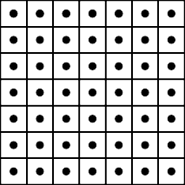
What if we want the output to be of same size as the input?
0 | 0 | 0 | 0 | 0 | 0 | 0 | 0 | 0
0 |  |  |  |  |  |  |  | 0
0 |  |  |  |  |  |  |  | 0
0 |  |  |  |  |  |  |  | 0
0 |  |  |  |  |  |  |  | 0
0 |  |  |  |  |  |  |  | 0
0 |  |  |  |  |  |  |  | 0
0 |  |  |  |  |  |  |  | 0
0 | 0 | 0 | 0 | 0 | 0 | 0 | 0 | 0
We can use something known as padding
Pad the inputs with appropriate number of 0 inputs so that you can now apply the kernel at the corners
Let us use pad P = 1 with a 3 × 3 kernel
This means we will add one row and one column of 0 inputs at the top, bottom, left and right
=
We now have, W₂ = W₁ − F + 2P + 1 H₂ = H₁ − F + 2P + 1
We will refine this formula further

Slide 162
What does the stride S do?

Slide 163
What does the stride S do?
It defines the intervals at which the filter is applied (here S = 2)

Slide 164
What does the stride S do?
0 | 0 | 0 | 0 | 0 | 0 | 0 | 0 | 0
0 |  |  |  |  |  |  |  | 0
0 |  |  |  |  |  |  |  | 0
0 |  |  |  |  |  |  |  | 0
0 |  |  |  |  |  |  |  | 0
0 |  |  |  |  |  |  |  | 0
0 |  |  |  |  |  |  |  | 0
0 |  |  |  |  |  |  |  | 0
0 | 0 | 0 | 0 | 0 | 0 | 0 | 0 | 0
It defines the intervals at which the filter is applied (here S = 2)
Here, we are essentially skipping every 2nd pixel which will again result in an output which is of smaller dimensions
=

Slide 165
What does the stride S do?
0 | 0 | 0 | 0 | 0 | 0 | 0 | 0 | 0
0 |  |  |  |  |  |  |  | 0
0 |  |  |  |  |  |  |  | 0
0 |  |  |  |  |  |  |  | 0
0 |  |  |  |  |  |  |  | 0
0 |  |  |  |  |  |  |  | 0
0 |  |  |  |  |  |  |  | 0
0 |  |  |  |  |  |  |  | 0
0 | 0 | 0 | 0 | 0 | 0 | 0 | 0 | 0
It defines the intervals at which the filter is applied (here S = 2)
Here, we are essentially skipping every 2nd pixel which will again result in an output which is of smaller dimensions
=

Slide 166
What does the stride S do?
0 | 0 | 0 | 0 | 0 | 0 | 0 | 0 | 0
0 |  |  |  |  |  |  |  | 0
0 |  |  |  |  |  |  |  | 0
0 |  |  |  |  |  |  |  | 0
0 |  |  |  |  |  |  |  | 0
0 |  |  |  |  |  |  |  | 0
0 |  |  |  |  |  |  |  | 0
0 |  |  |  |  |  |  |  | 0
0 | 0 | 0 | 0 | 0 | 0 | 0 | 0 | 0
It defines the intervals at which the filter is applied (here S = 2)
Here, we are essentially skipping every 2nd pixel which will again result in an output which is of smaller dimensions
=

Slide 167
What does the stride S do?
0 | 0 | 0 | 0 | 0 | 0 | 0 | 0 | 0
0 |  |  |  |  |  |  |  | 0
0 |  |  |  |  |  |  |  | 0
0 |  |  |  |  |  |  |  | 0
0 |  |  |  |  |  |  |  | 0
0 |  |  |  |  |  |  |  | 0
0 |  |  |  |  |  |  |  | 0
0 |  |  |  |  |  |  |  | 0
0 | 0 | 0 | 0 | 0 | 0 | 0 | 0 | 0
It defines the intervals at which the filter is applied (here S = 2)
Here, we are essentially skipping every 2nd pixel which will again result in an output which is of smaller dimensions
=

Slide 168
What does the stride S do?
0 | 0 | 0 | 0 | 0 | 0 | 0 | 0 | 0
0 |  |  |  |  |  |  |  | 0
0 |  |  |  |  |  |  |  | 0
0 |  |  |  |  |  |  |  | 0
0 |  |  |  |  |  |  |  | 0
0 |  |  |  |  |  |  |  | 0
0 |  |  |  |  |  |  |  | 0
0 |  |  |  |  |  |  |  | 0
0 | 0 | 0 | 0 | 0 | 0 | 0 | 0 | 0
It defines the intervals at which the filter is applied (here S = 2)
Here, we are essentially skipping every 2nd pixel which will again result in an output which is of smaller dimensions
=

Slide 169
What does the stride S do?
0 | 0 | 0 | 0 | 0 | 0 | 0 | 0 | 0
0 |  |  |  |  |  |  |  | 0
0 |  |  |  |  |  |  |  | 0
0 |  |  |  |  |  |  |  | 0
0 |  |  |  |  |  |  |  | 0
0 |  |  |  |  |  |  |  | 0
0 |  |  |  |  |  |  |  | 0
0 |  |  |  |  |  |  |  | 0
0 | 0 | 0 | 0 | 0 | 0 | 0 | 0 | 0
It defines the intervals at which the filter is applied (here S = 2)
Here, we are essentially skipping every 2nd pixel which will again result in an output which is of smaller dimensions
=

Slide 170
What does the stride S do?
0 | 0 | 0 | 0 | 0 | 0 | 0 | 0 | 0
0 |  |  |  |  |  |  |  | 0
0 |  |  |  |  |  |  |  | 0
0 |  |  |  |  |  |  |  | 0
0 |  |  |  |  |  |  |  | 0
0 |  |  |  |  |  |  |  | 0
0 |  |  |  |  |  |  |  | 0
0 |  |  |  |  |  |  |  | 0
0 | 0 | 0 | 0 | 0 | 0 | 0 | 0 | 0
It defines the intervals at which the filter is applied (here S = 2)
Here, we are essentially skipping every 2nd pixel which will again result in an output which is of smaller dimensions
=

Slide 171
What does the stride S do?
0 | 0 | 0 | 0 | 0 | 0 | 0 | 0 | 0
0 |  |  |  |  |  |  |  | 0
0 |  |  |  |  |  |  |  | 0
0 |  |  |  |  |  |  |  | 0
0 |  |  |  |  |  |  |  | 0
0 |  |  |  |  |  |  |  | 0
0 |  |  |  |  |  |  |  | 0
0 |  |  |  |  |  |  |  | 0
0 | 0 | 0 | 0 | 0 | 0 | 0 | 0 | 0
It defines the intervals at which the filter is applied (here S = 2)
Here, we are essentially skipping every 2nd pixel which will again result in an output which is of smaller dimensions
=

Slide 172
What does the stride S do?
0 | 0 | 0 | 0 | 0 | 0 | 0 | 0 | 0
0 |  |  |  |  |  |  |  | 0
0 |  |  |  |  |  |  |  | 0
0 |  |  |  |  |  |  |  | 0
0 |  |  |  |  |  |  |  | 0
0 |  |  |  |  |  |  |  | 0
0 |  |  |  |  |  |  |  | 0
0 |  |  |  |  |  |  |  | 0
0 | 0 | 0 | 0 | 0 | 0 | 0 | 0 | 0
It defines the intervals at which the filter is applied (here S = 2)
Here, we are essentially skipping every 2nd pixel which will again result in an output which is of smaller dimensions
=

Slide 173
What does the stride S do?
0 | 0 | 0 | 0 | 0 | 0 | 0 | 0 | 0
0 |  |  |  |  |  |  |  | 0
0 |  |  |  |  |  |  |  | 0
0 |  |  |  |  |  |  |  | 0
0 |  |  |  |  |  |  |  | 0
0 |  |  |  |  |  |  |  | 0
0 |  |  |  |  |  |  |  | 0
0 |  |  |  |  |  |  |  | 0
0 | 0 | 0 | 0 | 0 | 0 | 0 | 0 | 0
It defines the intervals at which the filter is applied (here S = 2)
Here, we are essentially skipping every 2nd pixel which will again result in an output which is of smaller dimensions
=

Slide 174
What does the stride S do?
0 | 0 | 0 | 0 | 0 | 0 | 0 | 0 | 0
0 |  |  |  |  |  |  |  | 0
0 |  |  |  |  |  |  |  | 0
0 |  |  |  |  |  |  |  | 0
0 |  |  |  |  |  |  |  | 0
0 |  |  |  |  |  |  |  | 0
0 |  |  |  |  |  |  |  | 0
0 |  |  |  |  |  |  |  | 0
0 | 0 | 0 | 0 | 0 | 0 | 0 | 0 | 0
It defines the intervals at which the filter is applied (here S = 2)
Here, we are essentially skipping every 2nd pixel which will again result in an output which is of smaller dimensions
=

Slide 175
What does the stride S do?
0 | 0 | 0 | 0 | 0 | 0 | 0 | 0 | 0
0 |  |  |  |  |  |  |  | 0
0 |  |  |  |  |  |  |  | 0
0 |  |  |  |  |  |  |  | 0
0 |  |  |  |  |  |  |  | 0
0 |  |  |  |  |  |  |  | 0
0 |  |  |  |  |  |  |  | 0
0 |  |  |  |  |  |  |  | 0
0 | 0 | 0 | 0 | 0 | 0 | 0 | 0 | 0
It defines the intervals at which the filter is applied (here S = 2)
Here, we are essentially skipping every 2nd pixel which will again result in an output which is of smaller dimensions
=

Slide 176
What does the stride S do?
0 | 0 | 0 | 0 | 0 | 0 | 0 | 0 | 0
0 |  |  |  |  |  |  |  | 0
0 |  |  |  |  |  |  |  | 0
0 |  |  |  |  |  |  |  | 0
0 |  |  |  |  |  |  |  | 0
0 |  |  |  |  |  |  |  | 0
0 |  |  |  |  |  |  |  | 0
0 |  |  |  |  |  |  |  | 0
0 | 0 | 0 | 0 | 0 | 0 | 0 | 0 | 0
It defines the intervals at which the filter is applied (here S = 2)
Here, we are essentially skipping every 2nd pixel which will again result in an output which is of smaller dimensions
=

Slide 177
What does the stride S do?
0 | 0 | 0 | 0 | 0 | 0 | 0 | 0 | 0
0 |  |  |  |  |  |  |  | 0
0 |  |  |  |  |  |  |  | 0
0 |  |  |  |  |  |  |  | 0
0 |  |  |  |  |  |  |  | 0
0 |  |  |  |  |  |  |  | 0
0 |  |  |  |  |  |  |  | 0
0 |  |  |  |  |  |  |  | 0
0 | 0 | 0 | 0 | 0 | 0 | 0 | 0 | 0
It defines the intervals at which the filter is applied (here S = 2)
Here, we are essentially skipping every 2nd pixel which will again result in an output which is of smaller dimensions
=

Slide 178
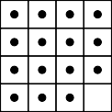
What does the stride S do?
0 | 0 | 0 | 0 | 0 | 0 | 0 | 0 | 0
0 |  |  |  |  |  |  |  | 0
0 |  |  |  |  |  |  |  | 0
0 |  |  |  |  |  |  |  | 0
0 |  |  |  |  |  |  |  | 0
0 |  |  |  |  |  |  |  | 0
0 |  |  |  |  |  |  |  | 0
0 |  |  |  |  |  |  |  | 0
0 | 0 | 0 | 0 | 0 | 0 | 0 | 0 | 0
It defines the intervals at which the filter is applied (here S = 2)
Here, we are essentially skipping every 2nd pixel which will again result in an output which is of smaller dimensions
=
So what should our final formula look like,

Slide 179
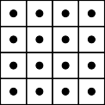
What does the stride S do?
0 | 0 | 0 | 0 | 0 | 0 | 0 | 0 | 0
0 |  |  |  |  |  |  |  | 0
0 |  |  |  |  |  |  |  | 0
0 |  |  |  |  |  |  |  | 0
0 |  |  |  |  |  |  |  | 0
0 |  |  |  |  |  |  |  | 0
0 |  |  |  |  |  |  |  | 0
0 |  |  |  |  |  |  |  | 0
0 | 0 | 0 | 0 | 0 | 0 | 0 | 0 | 0
It defines the intervals at which the filter is applied (here S = 2)
Here, we are essentially skipping every 2nd pixel which will again result in an output which is of smaller dimensions
=
So what should our final formula look like,
W₁ − F + 2P
W = + 1
2
S
H₁ − F + 2P
H = + 1
2
S

Slide 180

Finally, coming to the depth of the output.
ftlter
H1
W1
D1

Slide 181
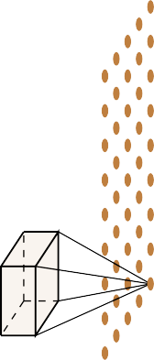
Finally, coming to the depth of the output.
Each filter gives us one 2D output.
H1
W1
D1

Slide 182

Finally, coming to the depth of the output.
Each filter gives us one 2D output.
K filters will give us K such 2D out- puts
H2
H1
W2
W1
D2 = K
D1
_{W2 =} W1−F +2P ₊ ₁
S
_{H2 =} H1−F +2P ₊ ₁
S
^{D}2 ^{= K}

Slide 183
Finally, coming to the depth of the output.
Each filter gives us one 2D output.
K filters will give us K such 2D out- puts
We can think of the resulting output as K × W₂ × H₂ volume
H2
H1
W2
W1
D2 = K
D1
_{W2 =} W1−F +2P ₊ ₁
S
_{H2 =} H1−F +2P ₊ ₁
S
^{D}2 ^{= K}

Slide 184
Finally, coming to the depth of the output.
Each filter gives us one 2D output.
K filters will give us K such 2D out- puts
We can think of the resulting output as K × W₂ × H₂ volume
Thus D₂ = K
H2
H1
W2
W1
D2 = K
D1
_{W2 =} W1−F +2P ₊ ₁
S
_{H2 =} H1−F +2P ₊ ₁
S
^{D}2 ^{= K}

Slide 185
Let us do a few exercises
H2 =?
11
∗
=
11
227
3
96 filters
Stride = 4
P adding = 0
W2 =?
227
_{W2 =} ^{W}1 ^{−F +2P} ₊ ₁
D2 =?
3
S
_{H2 =} ^{H}1 ^{−F +2P} ₊ ₁
S

Slide 186
Let us do a few exercises
H2 =?
11
∗
=
11
227
3
96 filters
Stride = 4
P adding = 0
W2 =?
227
_{W2 =} ^{W}1 ^{−F +2P} ₊ ₁
96
3
S
_{H2 =} ^{H}1 ^{−F +2P} ₊ ₁
S

Slide 187
Let us do a few exercises
₅₅ ₌ 227−11 ₊ ₁
4
11
∗
=
11
227
3
96 filters
Stride = 4
P adding = 0
W2 =?
227
_{W2 =} ^{W}1 ^{−F +2P} ₊ ₁
96
3
S
_{H2 =} ^{H}1 ^{−F +2P} ₊ ₁
S

Slide 188
Let us do a few exercises
₅₅ ₌ 227−11 ₊ ₁
4
11
∗
=
11
227
3
96 filters
Stride = 4
P adding = 0
₅₅ ₌ 227−11 ₊ ₁
4
227
_{W2 =} ^{W}1 ^{−F +2P} ₊ ₁
96
3
S
_{H2 =} ^{H}1 ^{−F +2P} ₊ ₁
S

Slide 189
Let us do a few exercises
H2 =?
5
∗
=
5
32
1
6 filters
Stride = 1
P adding = 0
W2 =?
32
_{W2 =} ^{W}1 ^{−F +2P} ₊ ₁
D2 =?
1
S
_{H2 =} ^{H}1 ^{−F +2P} ₊ ₁
S

Slide 190
Let us do a few exercises
H2 =?
5
∗
=
5
32
1
6 filters
Stride = 1
P adding = 0
W2 =?
32
_{W2 =} ^{W}1 ^{−F +2P} ₊ ₁
6
1
S
_{H2 =} ^{H}1 ^{−F +2P} ₊ ₁
S

Slide 191
Let us do a few exercises
28 = ³²⁻⁵ + 1
1
5
∗
=
5
32
1
6 filters
Stride = 1
P adding = 0
W2 =?
32
_{W2 =} ^{W}1 ^{−F +2P} ₊ ₁
6
1
S
_{H2 =} ^{H}1 ^{−F +2P} ₊ ₁
S

Slide 192
Let us do a few exercises
28 = ³²⁻⁵ + 1
1
5
∗
=
5
32
1
6 filters
Stride = 1
P adding = 0
28 = ³²⁻⁵ + 1
1
32
_{W2 =} ^{W}1 ^{−F +2P} ₊ ₁
6
1
S
_{H2 =} ^{H}1 ^{−F +2P} ₊ ₁
S

Slide 193
Convolutional Neural Networks

Slide 194
Putting things into perspective
What is the connection between this operation (convolution) and neural net- works?

Slide 195
Putting things into perspective
What is the connection between this operation (convolution) and neural net- works?
We will try to understand this by considering the task of “image classification”

Slide 197
Features
Raw pixels

Slide 198
Features
Raw pixels
car, bus,monument, flower

Slide 199
Features
Raw pixels
car, bus,monument, flower

Slide 200
Features
Raw pixels
car, bus,monument, flower
Edge Detector

Slide 201
Features
Raw pixels
car, bus,monument, flower
Edge Detector
car, bus,monument, flower

Slide 202
Features
Raw pixels
car, bus,monument, flower
Edge Detector
car, bus,monument, flower

Slide 203
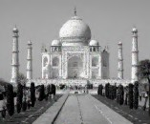
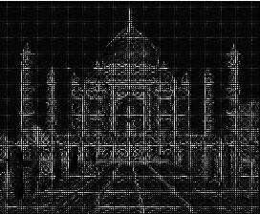
Features
Raw pixels
car, bus,monument, flower
Edge Detector
car, bus,monument, flower
SIF T /HOG

Slide 204
Features
Raw pixels
car, bus,monument, flower
Edge Detector
car, bus,monument, flower
SIF T /HOG
car, bus,monument, flower

Slide 205
Features
Raw pixels
car, bus,monument, flower
Edge Detector
car, bus,monument, flower
SIF T /HOG
car, bus,monument, flower
static feature extraction (no learning) learning weights of classifier

Slide 206
Input
Features
Classifier
car, bus,monument, flower
0 0 0 0 0
0 1 1 1 0
0 1 -8 1 0
0 1 1 1 0
0 0 0 0 0
Instead of using handcrafted kernels such as edge detectors can we learn meaningful ker- nels/ftlters in addition to learning the weights of the classifter?

Slide 207
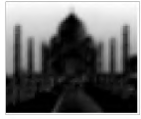
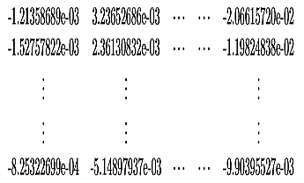
Input
Features
Classifier
car, bus,monument, flower
0 0 0 0 0
0 1 1 1 0
0 1 -8 1 0
0 1 1 1 0
0 0 0 0 0
car, bus,monument, flower
Instead of using handcrafted kernels such as edge detectors can we learn meaningful ker-
nels/ftlters in addition to learning the weights of the classifter?

Slide 208
Input
Features
Classifier
car, bus,monument, flower
0 0 0 0 0
0 1 1 1 0
0 1 -8 1 0
0 1 1 1 0
0 0 0 0 0
car, bus,monument, flower
-1.21358689e-03 3.23652686e-03 ··· ··· -2.06615720e-02
-1.52757822e-03 2.36130832e-03 ··· ··· -1.19824838e-02
.. .. ..
Learn these weights
. .
.
.. ..
..
. . .
-8.25322699e-04 -5.14897937e-03 ··· ··· -9.90395527e-03
Instead of using handcrafted kernels such as edge detectors can we learn meaningful ker- nels/ftlters in addition to learning the weights of the classifter?

Slide 209
Input
Features
Classifier
car, bus,monument, flower
0 0 0 0 0
0 1 1 1 0
0 1 -8 1 0
0 1 1 1 0
0 0 0 0 0
car, bus,monument, flower
-8.25322699e-04 -5.14897937e-03 ··· ··· -9.90395527e-03
Even better: Instead of using handcrafted kernels (such as edge detectors)can we learn multiple meaningful kernels/ftlters in addition to learning the weights of the clas-
sifter?

Slide 210
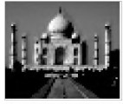
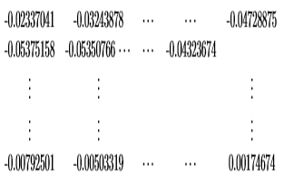
Input
Features
Classifier
car, bus,monument, flower
0 0 0 0 0
0 1 1 1 0
0 1 -8 1 0
0 1 1 1 0
0 0 0 0 0
car, bus,monument, flower
-0.00792501 -0.00503319 ··· ··· 0.00174674
Even better: Instead of using handcrafted kernels (such as edge detectors)can we learn multiple meaningful kernels/ftlters in addition to learning the weights of the clas- sifter?

Slide 211
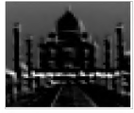
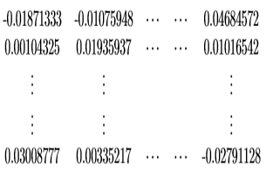
Input
Features
Classifier
car, bus,monument, flower
0 0 0 0 0
0 1 1 1 0
0 1 -8 1 0
0 1 1 1 0
0 0 0 0 0
car, bus,monument, flower
0.03008777 0.00335217 ··· ··· -0.02791128
Even better: Instead of using handcrafted kernels (such as edge detectors)can we learn multiple meaningful kernels/ftlters in addition to learning the weights of the clas-
sifter?

Slide 212
Can we learn multiple layers of meaningful kernels/ftlters in addition to learning the weights of the classifter?

Slide 213
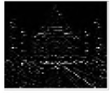
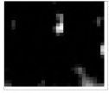
Input
Classifier
car, bus,monument, flower
Can we learn multiple layers of meaningful kernels/ftlters in addition to learning the weights of the classifter?
Yes, we can !

Slide 214
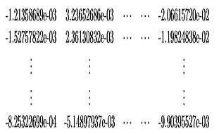
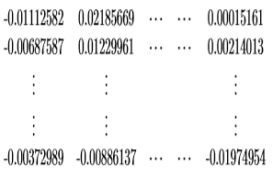
Input
Classifier
car, bus,monument, flower
backpropagation
Can we learn multiple layers of meaningful kernels/ftlters in addition to learning the weights of the classifter?
Yes, we can !
Simply by treating these kernels as parameters and learning them in addition to the weights of the classifier (using back propagation)

Slide 215
Input
Classifier
car, bus,monument, flower
-1.21358689e-03 3.23652686e-03 ··· ··· -2.06615720e-02
-1.52757822e-03 2.36130832e-03 ··· ··· -1.19824838e-02
-0.00687587 0.01229961 ··· ··· 0.00214013
backpropagation
.. .. ..
.. .. ..
. . .
. .
.
.. .. ..
.. ..
..
. . .
-8.25322699e-04 -5.14897937e-03 ··· ··· -9.90395527e-03
. . .
-0.00372989 -0.00886137 ··· ··· -0.01974954
Can we learn multiple layers of meaningful kernels/ftlters in addition to learning the weights of the classifter?
Yes, we can !
Simply by treating these kernels as parameters and learning them in addition to the weights of the classifier (using back propagation)
Such a network is called a Convolutional Neural Network.

Slide 216
Okay, I get it that the idea is to learn the kernel/filters by just treating them as parameters of the classification model

Slide 217
Okay, I get it that the idea is to learn the kernel/filters by just treating them as parameters of the classification model
But how is this different from a regular feedforward neural network

Slide 218
Okay, I get it that the idea is to learn the kernel/filters by just treating them as parameters of the classification model
But how is this different from a regular feedforward neural network Let us see

Slide 219
2

Slide 220
16
2

Slide 221
10 classes(digits)
16
2

Slide 222
10 classes(digits)
16
2

Slide 223
10 classes(digits)
16
2

Slide 224
10 classes(digits)
. . .
16
2

Slide 225

10 classes(digits)
. . .
16
2

Slide 226
10 classes(digits)
. . .
16
2

Slide 227
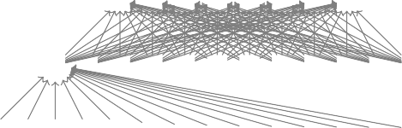
10 classes(digits)
. . .
16
2

Slide 228
This is what a regular feed-forward neural network will look like
10 classes(digits)
. . .
16
2

Slide 229
This is what a regular feed-forward neural network will look like
10 classes(digits)
. . .
There are many dense connections here
16
2

Slide 230
This is what a regular feed-forward neural network will look like
10 classes(digits)
. . .
There are many dense connections here
For example all the 16 input neurons are contributing to the computation of h₁₁
16
2

Slide 231
This is what a regular feed-forward neural network will look like
10 classes(digits)
. . .
There are many dense connections here
For example all the 16 input neurons are contributing to the computation of h₁₁
16
Contrast this to what happens in the case of convolution
2

Slide 232
. . .
16
2
*
=

Slide 233
Only a few local neurons participate in the computation of h₁₁
. . .
16
2
*
=

Slide 234
h11
Only a few local neurons participate in the computation of h₁₁
. . .
For example, only pixels 1, 2, 5, 6 contribute to h₁₁
16
2
h11
=
*

Slide 235
h11 h12
Only a few local neurons participate in the computation of h₁₁
. . .
For example, only pixels 1, 2, 5, 6 contribute to h₁₁
16
2
h12
=
*

Slide 236
h11 h12
Only a few local neurons participate in the computation of h₁₁
. . .
For example, only pixels 1, 2, 5, 6 contribute to h₁₁
16
2
h13
=
*

Slide 237
h11 h12
Only a few local neurons participate in the computation of h₁₁
. . .
For example, only pixels 1, 2, 5, 6 contribute to h₁₁
16
2
h14
=
*

Slide 238
h11 h12
Only a few local neurons participate in the computation of h₁₁
. . .
For example, only pixels 1, 2, 5, 6 contribute to h₁₁
16
The connections are much sparser
2
h14
=
*

Slide 239
h11 h12
Only a few local neurons participate in the computation of h₁₁
. . .
For example, only pixels 1, 2, 5, 6 contribute to h₁₁
16
The connections are much sparser
We are taking advantage of the structure of the image(interactions between neighboring pixels are more interesting)
2
h14
*
=

Slide 240
h11 h12
Only a few local neurons participate in the computation of h₁₁
. . .
For example, only pixels 1, 2, 5, 6 contribute to h₁₁
16
The connections are much sparser
We are taking advantage of the structure of the image(interactions between neighboring pixels are more interesting)
2
h14
*
=
This sparse connectivity reduces the number of parameters in the model

Slide 241
But is sparse connectivity really good thing ?

Slide 242
But is sparse connectivity really good thing ?
Aren’t we losing information (by los- ing interactions between some input pixels)

Slide 243
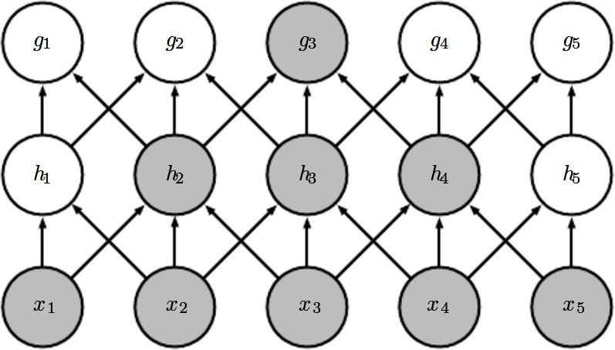
But is sparse connectivity really good thing ?
Aren’t we losing information (by los- ing interactions between some input pixels)
Well, not really

Slide 244
But is sparse connectivity really good thing ?
Aren’t we losing information (by los- ing interactions between some input pixels)
Well, not really
The two highlighted neurons (x₁ &
x₅)∗ do not interact in layer 1

Slide 245
But is sparse connectivity really good thing ?
Aren’t we losing information (by los- ing interactions between some input pixels)
Well, not really
The two highlighted neurons (x₁ &
x₅)∗ do not interact in layer 1
But they indirectly contribute to the computation of g₃ and hence interact indirectly

Slide 246
Another characteristic of CNNs is weight sharing

Slide 247
Another characteristic of CNNs is weight sharing
Consider the following net- work

Slide 248
Another characteristic of CNNs is weight sharing
Consider the following net- work
Do we want the kernel weights to be diﬀerent for different portions of the image?
16
Kernel 1
Kernel 2
4x4 Image

Slide 249
Another characteristic of CNNs is weight sharing
Consider the following net- work
Do we want the kernel weights to be diﬀerent for different portions of the image?
Imagine that we are trying to learn a kernel that detects edges
16
Kernel 1
Kernel 2
4x4 Image

Slide 250
Another characteristic of CNNs is weight sharing
Consider the following net- work
Do we want the kernel weights to be diﬀerent for different portions of the image?
Imagine that we are trying to learn a kernel that detects edges
Shouldn’t we be applying the same kernel at all the portions of the image?
16
Kernel 1
Kernel 2
4x4 Image

Slide 251
In other words shouldn’t the orange
and pink kernels be the same
16

Slide 252
In other words shouldn’t the orange
and pink kernels be the same
Yes, indeed
16

Slide 253
In other words shouldn’t the orange
and pink kernels be the same
Yes, indeed
This would make the job of learning easier(instead of trying to learn the same weights/kernels at different loc- ations again and again)
16

Slide 254
In other words shouldn’t the orange
and pink kernels be the same
Yes, indeed
This would make the job of learning easier(instead of trying to learn the same weights/kernels at different loc- ations again and again)
But does that mean we can have only one kernel?
16

Slide 255
In other words shouldn’t the orange
and pink kernels be the same
Yes, indeed
This would make the job of learning easier(instead of trying to learn the same weights/kernels at different loc- ations again and again)
But does that mean we can have only one kernel?
16
No, we can have many such kernels but the kernels will be shared by all locations in the image

Slide 256
In other words shouldn’t the orange
and pink kernels be the same
Yes, indeed
This would make the job of learning easier(instead of trying to learn the same weights/kernels at different loc- ations again and again)
But does that mean we can have only one kernel?
16
No, we can have many such kernels but the kernels will be shared by all locations in the image

Slide 257
In other words shouldn’t the orange
and pink kernels be the same
Yes, indeed
This would make the job of learning easier(instead of trying to learn the same weights/kernels at different loc- ations again and again)
But does that mean we can have only one kernel?
16
No, we can have many such kernels but the kernels will be shared by all locations in the image

Slide 258
In other words shouldn’t the orange
and pink kernels be the same
Yes, indeed
This would make the job of learning easier(instead of trying to learn the same weights/kernels at different loc- ations again and again)
But does that mean we can have only one kernel?
16
No, we can have many such kernels but the kernels will be shared by all locations in the image
This is called “weight sharing”

Slide 259
So far, we have focused only on the convolution operation

Slide 260
So far, we have focused only on the convolution operation Let us see what a full convolutional neural network looks like

Slide 261
Convolution Layer 2
Input
Convolution Layer 1
Pooling Layer 2
A
Pooling Layer
1
^{FC 1(120)FC 2(84)}Output(10)
32
28
14
32
_{P aram P aram} P aram
28
14
10
5 ₌ ₄₈₁₂₀= 10164 ⁼ ⁸⁵⁰
10
5
S = 1,F = 5,
K = 6,P = 0,
P aram = 150
S = 1,F = 2,
K = 6,P = 0,
P aram = 0
S = 1,F = 5, S = 1,F = 2,
K = 16,P = 0, K = 16,P = 0,
P aram = 2400 P aram = 0

Slide 262
Convolution Layer 2
Input
Convolution Layer 1
Pooling Layer 2
A
Pooling Layer
1
^{FC 1(120)FC 2(84)}Output(10)
32
28
14
32
_{P aram P aram} P aram
28
14
10
5 ₌ ₄₈₁₂₀= 10164 ⁼ ⁸⁵⁰
10
5
S = 1,F = 5,
K = 6,P = 0,
P aram = 150
S = 1,F = 2,
K = 6,P = 0,
P aram = 0
S = 1,F = 5, S = 1,F = 2,
K = 16,P = 0, K = 16,P = 0,
P aram = 2400 P aram = 0
It has alternate convolution and pooling layers

Slide 263
Convolution Layer 2
Input
Convolution Layer 1
Pooling Layer 2
A
Pool
ing Layer
1
^{FC 1(120)FC 2(84)}Output(10)
32
28
14
32
_{P aram P aram} P aram
28
14
10
5 ₌ ₄₈₁₂₀= 10164 ⁼ ⁸⁵⁰
10
5
S = 1,F = 5,
K = 6,P = 0,
P aram = 150
S = 1,F = 2,
K = 6,P = 0,
P aram = 0
S = 1,F = 5, S = 1,F = 2,
K = 16,P = 0, K = 16,P = 0,
P aram = 2400 P aram = 0
It has alternate convolution and pooling layers What does a pooling layer do?

Slide 264
Convolution Layer 2
Input
Convolution Layer 1
Pooling Layer 2
A
Pooling Layer
1
^{FC 1(120)FC 2(84)}Output(10)
32
28
14
32
_{P aram P aram} P aram
28
14
10
5 ₌ ₄₈₁₂₀= 10164 ⁼ ⁸⁵⁰
10
5
S = 1,F = 5,
K = 6,P = 0,
P aram = 150
S = 1,F = 2,
K = 6,P = 0,
P aram = 0
S = 1,F = 5, S = 1,F = 2,
K = 16,P = 0, K = 16,P = 0,
P aram = 2400 P aram = 0
It has alternate convolution and pooling layers What does a pooling layer do?
Let us see

Slide 265
Input

Slide 266
*
Input
1 ftlter

Slide 267
*
=
Input
1 ftlter

Slide 268
1 | 4 | 2 | 1
5 | 8 | 3 | 4
7 | 6 | 4 | 5
1 | 3 | 1 | 2
*
=
Input
1 ftlter

Slide 269
1 | 4 | 2 | 1
5 | 8 | 3 | 4
7 | 6 | 4 | 5
1 | 3 | 1 | 2
maxpool
*
=
2x2 ftlters (stride 2)
Input
1 ftlter

Slide 270
1 | 4 | 2 | 1
5 | 8 | 3 | 4
7 | 6 | 4 | 5
1 | 3 | 1 | 2
maxpool
*
=
2x2 ftlters (stride 2)
Input
1 ftlter

Slide 271
1 | 4 | 2 | 1
5 | 8 | 3 | 4
7 | 6 | 4 | 5
1 | 3 | 1 | 2
maxpool
8
*
=
2x2 ftlters (stride 2)
Input
1 ftlter

Slide 272
1 | 4 | 2 | 1
5 | 8 | 3 | 4
7 | 6 | 4 | 5
1 | 3 | 1 | 2
maxpool
8 | 4
*
=
2x2 ftlters (stride 2)
Input
1 ftlter

Slide 273
1 | 4 | 2 | 1
5 | 8 | 3 | 4
7 | 6 | 4 | 5
1 | 3 | 1 | 2
maxpool
8 | 4
7
*
=
2x2 ftlters (stride 2)
Input
1 ftlter

Slide 274
1 | 4 | 2 | 1
5 | 8 | 3 | 4
7 | 6 | 4 | 5
1 | 3 | 1 | 2
maxpool
8 | 4
7 | 5
*
=
2x2 ftlters (stride 2)
Input
1 ftlter

Slide 275
1 | 4 | 2 | 1
5 | 8 | 3 | 4
7 | 6 | 4 | 5
1 | 3 | 1 | 2
maxpool
8 | 4
7 | 5
*
=
2x2 ftlters (stride 2)
Input
1 ftlter
1 | 4 | 2 | 1
5 | 8 | 3 | 4
7 | 6 | 4 | 5
1 | 3 | 1 | 2

Slide 276
1 | 4 | 2 | 1
5 | 8 | 3 | 4
7 | 6 | 4 | 5
1 | 3 | 1 | 2
maxpool
8 | 4
7 | 5
*
=
2x2 ftlters (stride 2)
Input
1 ftlter
1 | 4 | 2 | 1
5 | 8 | 3 | 4
7 | 6 | 4 | 5
1 | 3 | 1 | 2
maxpool
2x2 ftlters (stride 1)

Slide 277
1 | 4 | 2 | 1
5 | 8 | 3 | 4
7 | 6 | 4 | 5
1 | 3 | 1 | 2
maxpool
8 | 4
7 | 5
*
=
2x2 ftlters (stride 2)
Input
1 ftlter
1 | 4 | 2 | 1
5 | 8 | 3 | 4
7 | 6 | 4 | 5
1 | 3 | 1 | 2
maxpool
2x2 ftlters (stride 1)

Slide 278
1 | 4 | 2 | 1
5 | 8 | 3 | 4
7 | 6 | 4 | 5
1 | 3 | 1 | 2
maxpool
8 | 4
7 | 5
*
=
2x2 ftlters (stride 2)
Input
1 ftlter
1 | 4 | 2 | 1
5 | 8 | 3 | 4
7 | 6 | 4 | 5
1 | 3 | 1 | 2
maxpool
2x2 ftlters (stride 1)
8

Slide 279
1 | 4 | 2 | 1
5 | 8 | 3 | 4
7 | 6 | 4 | 5
1 | 3 | 1 | 2
maxpool
8 | 4
7 | 5
*
=
2x2 ftlters (stride 2)
Input
1 ftlter
1 | 4 | 2 | 1
5 | 8 | 3 | 4
7 | 6 | 4 | 5
1 | 3 | 1 | 2
maxpool
2x2 ftlters (stride 1)
8 | 8

Slide 280
1 | 4 | 2 | 1
5 | 8 | 3 | 4
7 | 6 | 4 | 5
1 | 3 | 1 | 2
maxpool
8 | 4
7 | 5
*
=
2x2 ftlters (stride 2)
Input
1 ftlter
1 | 4 | 2 | 1
5 | 8 | 3 | 4
7 | 6 | 4 | 5
1 | 3 | 1 | 2
maxpool
2x2 ftlters (stride 1)
8 | 8 | 4

Slide 281
1 | 4 | 2 | 1
5 | 8 | 3 | 4
7 | 6 | 4 | 5
1 | 3 | 1 | 2
maxpool
8 | 4
7 | 5
*
=
2x2 ftlters (stride 2)
Input
1 ftlter
1 | 4 | 2 | 1
5 | 8 | 3 | 4
7 | 6 | 4 | 5
1 | 3 | 1 | 2
maxpool
2x2 ftlters (stride 1)
8 | 8 | 4
8

Slide 282
1 | 4 | 2 | 1
5 | 8 | 3 | 4
7 | 6 | 4 | 5
1 | 3 | 1 | 2
maxpool
8 | 4
7 | 5
*
=
2x2 ftlters (stride 2)
Input
1 ftlter
1 | 4 | 2 | 1
5 | 8 | 3 | 4
7 | 6 | 4 | 5
1 | 3 | 1 | 2
maxpool
2x2 ftlters (stride 1)
8 | 8 | 4
8 | 8

Slide 283
1 | 4 | 2 | 1
5 | 8 | 3 | 4
7 | 6 | 4 | 5
1 | 3 | 1 | 2
maxpool
8 | 4
7 | 5
*
=
2x2 ftlters (stride 2)
Input
1 ftlter
1 | 4 | 2 | 1
5 | 8 | 3 | 4
7 | 6 | 4 | 5
1 | 3 | 1 | 2
maxpool
2x2 ftlters (stride 1)
8 | 8 | 4
8 | 8 | 5

Slide 284
1 | 4 | 2 | 1
5 | 8 | 3 | 4
7 | 6 | 4 | 5
1 | 3 | 1 | 2
maxpool
8 | 4
7 | 5
*
=
2x2 ftlters (stride 2)
Input
1 ftlter
1 | 4 | 2 | 1
5 | 8 | 3 | 4
7 | 6 | 4 | 5
1 | 3 | 1 | 2
maxpool
2x2 ftlters (stride 1)
8 | 8 | 4
8 | 8 | 5
7

Slide 285
1 | 4 | 2 | 1
5 | 8 | 3 | 4
7 | 6 | 4 | 5
1 | 3 | 1 | 2
maxpool
8 | 4
7 | 5
*
=
2x2 ftlters (stride 2)
Input
1 ftlter
1 | 4 | 2 | 1
5 | 8 | 3 | 4
7 | 6 | 4 | 5
1 | 3 | 1 | 2
maxpool
2x2 ftlters (stride 1)
8 | 8 | 4
8 | 8 | 5
7 | 6

Slide 286
1 | 4 | 2 | 1
5 | 8 | 3 | 4
7 | 6 | 4 | 5
1 | 3 | 1 | 2
maxpool
8 | 4
7 | 5
*
=
2x2 ftlters (stride 2)
Input
1 ftlter
1 | 4 | 2 | 1
5 | 8 | 3 | 4
7 | 6 | 4 | 5
1 | 3 | 1 | 2
maxpool
2x2 ftlters (stride 1)
8 | 8 | 4
8 | 8 | 5
7 | 6 | 5

Slide 287
1 | 4 | 2 | 1
5 | 8 | 3 | 4
7 | 6 | 4 | 5
1 | 3 | 1 | 2
maxpool
8 | 4
7 | 5
*
=
2x2 ftlters (stride 2)
Input
1 ftlter
1 | 4 | 2 | 1
5 | 8 | 3 | 4
7 | 6 | 4 | 5
1 | 3 | 1 | 2
maxpool
2x2 ftlters (stride 1)
8 | 8 | 4
8 | 8 | 5
7 | 6 | 5
Instead of max pooling we can also do average pooling

Slide 288
Normalization
Keep the math from breaking by tweaking each of the values just a bit.
Change everything negative to zero.

Slide 289
Rectified Linear Units (ReLUs)

Slide 290
Rectified Linear Units (ReLUs)

Slide 291
Rectified Linear Units (ReLUs)

Slide 292
Rectified Linear Units (ReLUs)

Slide 293
ReLU layer
A stack of images becomes a stack of images with no negative values.

Slide 294
Layers get stacked
The output of one becomes the input of the next.
Convolution
ReLU
Pooling

Slide 295
Deep stacking
Layers can be repeated several (or many) times.
Convolution
ReLU
Convolution
ReLU
Pooling
Convolution
ReLU
Pooling

Slide 296
Fully connected layer
Every value gets a vote

Slide 297
Fully connected layer
Vote depends on how strongly a value predicts X or O
X
O

Slide 298
Fully connected layer
Vote depends on how strongly a value predicts X or O
X
O

Slide 299
Fully connected layer
Future values vote on X or O
X
O

Slide 300
Fully connected layer
Future values vote on X or O
X
O

Slide 301
Fully connected layer
Future values vote on X or O
X
.92
O

Slide 302
Fully connected layer
Future values vote on X or O
X
.92
O

Slide 303
Fully connected layer
Future values vote on X or O
X
.92
O
.51

Slide 304
Fully connected layer
Future values vote on X or O
X
.92
O
.51

Slide 305
Fully connected layer
A list of feature values becomes a list of votes.
X
O

Slide 306
Fully connected layer
These can also be stacked.
X
O

Slide 307
Putting it all together
A set of pixels becomes a set of votes.
.92
X
Convolution
ReLU
Fully
connected
Fully
connected
Convolution
ReLU
Convolution
ReLU
Pooling
Pooling
O
.51

Slide 308
Learning
Q: Where do all the magic numbers come from?
Features in convolutional layers
Voting weights in fully connected layers
A: Backpropagation

Slide 309
Backpropagation
Error = right answer – actual answer
.92
X
Convolution
ReLU
Fully
connected
Fully
connected
Convolution
ReLU
Convolution
ReLU
Pooling
Pooling
O
.51

Slide 310
Backprop
.92
X
Convolution
ReLU
Fully
connected
Fully
connected
Convolution
ReLU
Convolution
ReLU
Pooling
Pooling
O
.51

Slide 311
Backprop
.92
X
Convolution
ReLU
Fully
connected
Fully
connected
Convolution
ReLU
Convolution
ReLU
Pooling
Pooling
O
.51

Slide 312
Backprop
.92
X
Convolution
ReLU
Fully
connected
Fully
connected
Convolution
ReLU
Convolution
ReLU
Pooling
Pooling
O
.51

Slide 313
Backprop
.92
.92
X
Convolution
ReLU
Fully
connected
Fully
connected
Convolution
ReLU
Convolution
ReLU
Pooling
Pooling
O
.51

Slide 314
Backprop
.92
.92
X
Convolution
ReLU
Fully
connected
Fully
connected
Convolution
ReLU
Convolution
ReLU
Pooling
Pooling
O
.51

Slide 315
Gradient descent
For each feature pixel and voting weight, adjust it up and down a bit and see how the error changes.
error
weight

Slide 316
Gradient descent
For each feature pixel and voting weight, adjust it up and down a bit and see how the error changes.
error
weight

Slide 317
Hyperparameters (knobs)
Convolution
Number of features
Size of features
Pooling
Window size
Window stride
Fully Connected
Number of neurons

Slide 318
Architecture
How many of each type of layer?
In what order?

Slide 319
Not just images
Any 2D (or 3D) data.
Things closer together are more closely related than things far away.

Slide 320
Images
Columns of pixels
Rows of pixels

Slide 321
Sound
Time steps
Intensity in each
frequency band

Slide 322
Text
Position in
sentence
Words in
dictionary

Slide 323
Limitations
ConvNets only capture local “spatial” patterns in data.
If the data can’t be made to look like an image, ConvNets are less useful.

Slide 324
Customer data
Name, age,
address, email,
purchases,
browsing activity,…
Customers

Slide 325
Rule of thumb
If your data is just as useful after swapping any of your columns with each other, then you can’t use Convolutional Neural Networks.

Slide 326
In a nutshell
ConvNets are great at finding patterns and using them to classify images.

